Slide 1
On Guided and Automatic Control Configuration Selection
Miguel Castaño Arranz Luleå University of Technology
Wolfgang Birk Luleå University of Technology
Ali Kadhim Luleå University of Technology

Slide 2
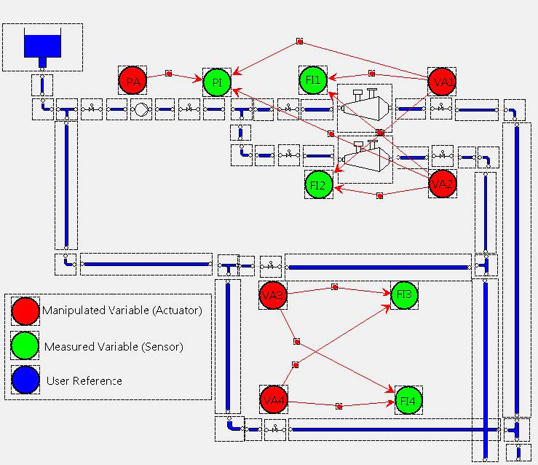
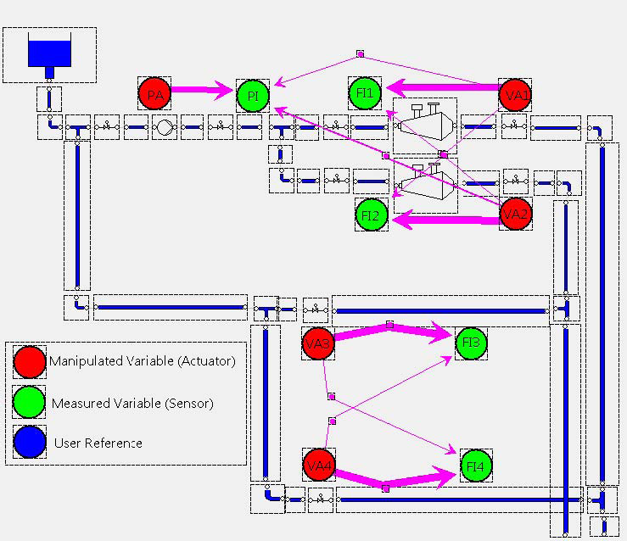
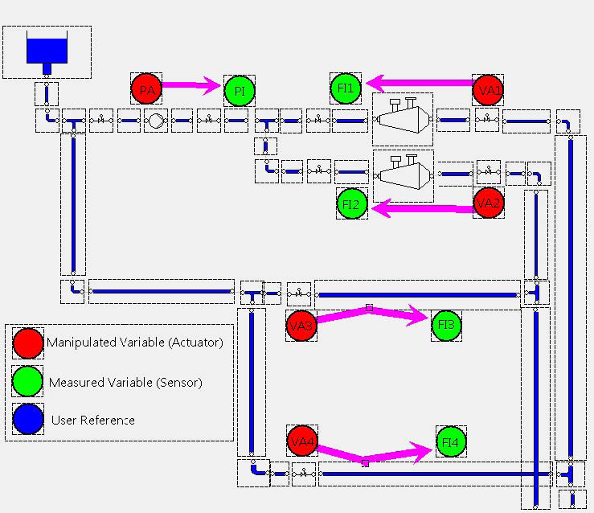
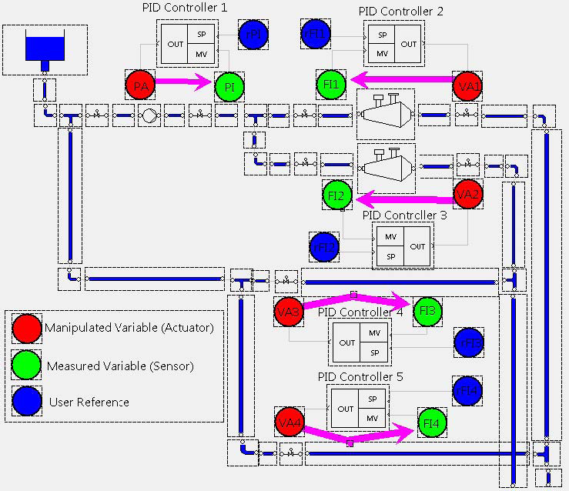
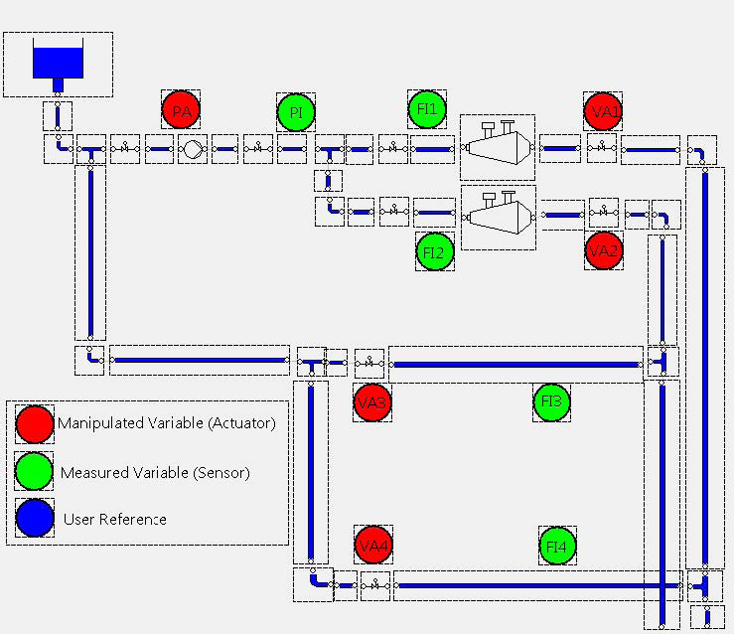






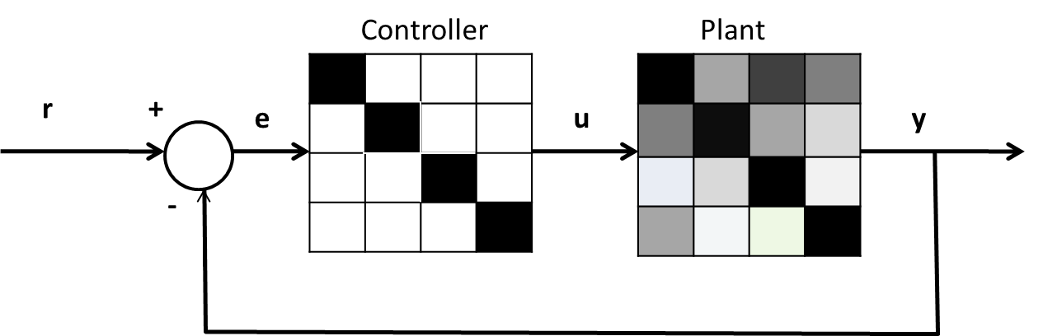
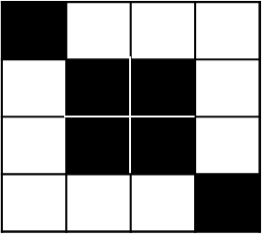


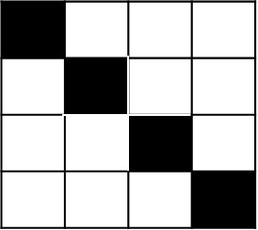
A procedure for control design of complex processes
Example: Stock Preparation Plant at SCA Obbola AB, Sweden
Subset of sensors and actuators
(IO Selection)
Model
Control Configuration
Performance specification
Controller parameters
Implemented controller
The goal of Control Configuration Selection using Interaction Measures (IMs) is to find the smallest number and location of control loops which can yield satisfactory performance
IMs consider controllability/observability, stability and integrity

Slide 3
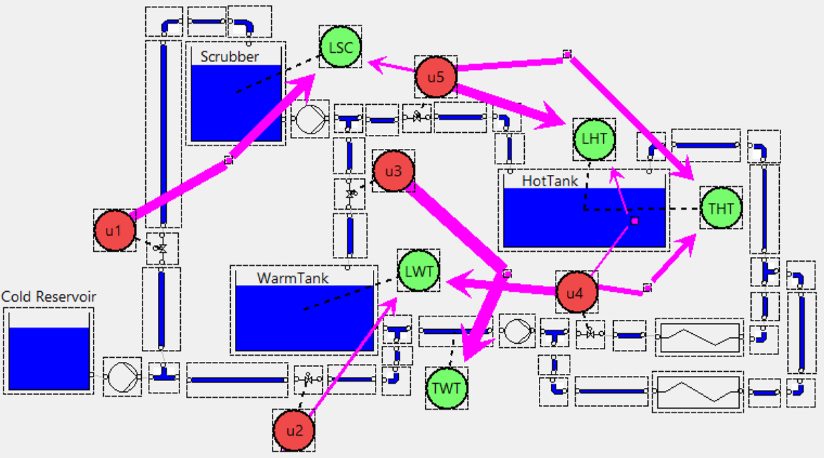
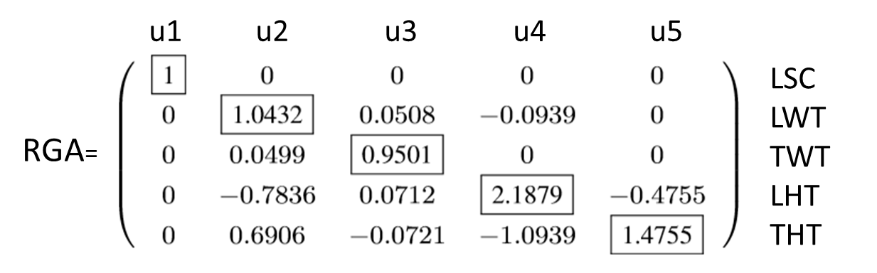
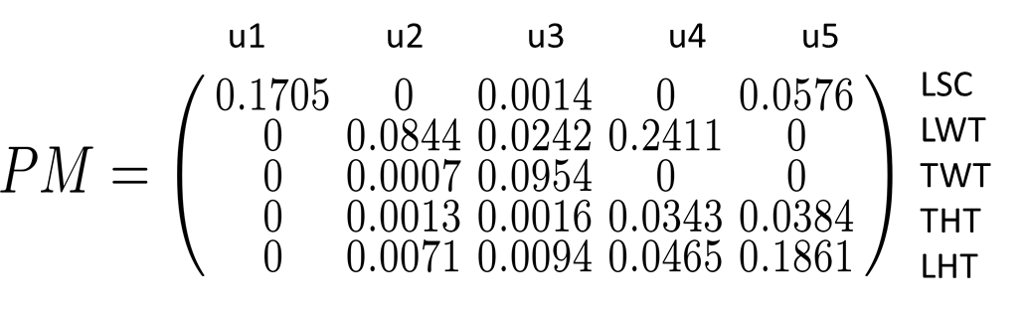
Guided and Automaticc Control Configuration Selection (CCS) using Interaction Measures (IMs)
It is well-accepted that the indications from different IMs should be combined for CCS.
During a CCS course engineers reached different configurations after being introduced to the same selection rules.
Existing selection rules are therefore not explicit enough.
There are not clear guidelines to combine several IMs in the CCS method.
The current selection rules are hard to apply to systems with several inputs and outputs.
The synthesis of controller parameters for sparse controllers is not clearly addressed in literature.
This paper targets the introduction of guidelines for CCS and the discussion of necessary steps like i/o selection, model scaling and process decomposition, as well as the design of sparse controllers
This paper introduces automatic CCS methods which aims at formulating optimization schemes for the selection of control configurations using IMs.
Relative Gain Array (RGA)
Basedd only on DC gains
Inputs and outputs are paired
Choose number close to 1
Negative values are associated to
lack of stability or integrity
Participation Matrix (PM)
Sparse configurations are designed
by picking the most relevant values
Includes process dynamics in the analysis
Does not consider stability conditions
Case Study on a real life Secondaty Heating System from Pulp & Paper Industry

